Slide 1




www.hologen-network.eu
Theoretical and practical introduction to hologenomics
Ostaizka Aizpurua
ostaizka.aizpurua@sund.ku.dk

Slide 2

www.hologen-network.org
Advancing the development and implementation of hologenomics in biological sciences
Funded by the European Union under Grant Agreement 101169005

Slide 3
www.hologen-network.eu
What does hologenomics mean?
1 min to think on your own
2 min to share in pairs

Slide 4
www.hologen-network.eu
Hologenomics
Hologenome
The integrated study of the genetic features of a eukaryotic host alongside that of its associated microbes
The entirety of the genetic information contained by a eukaryotic host and the microbial community associated with that host

Slide 5
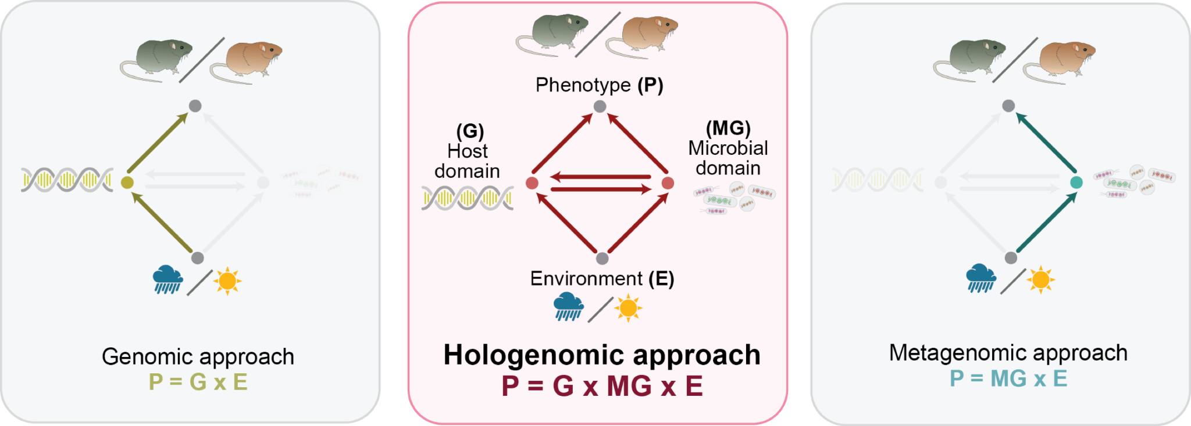
www.hologen-network.eu

Slide 6
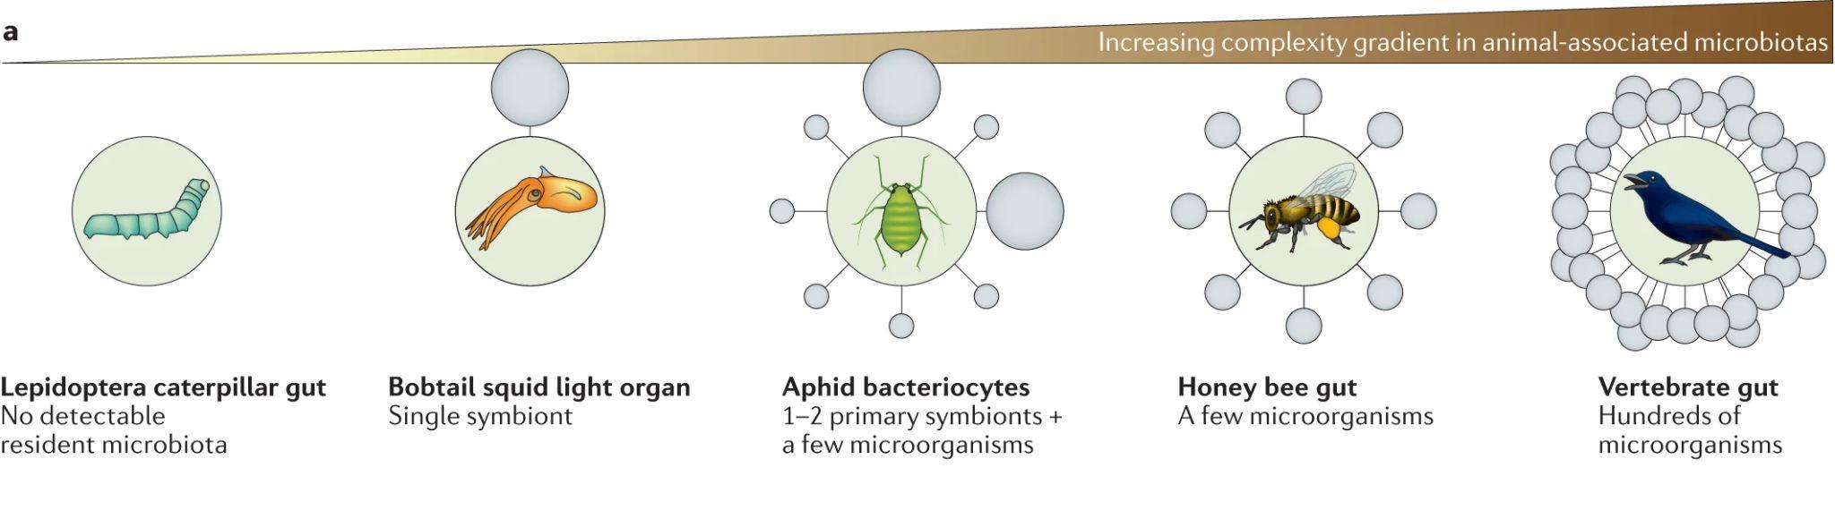
www.hologen-network.eu
Alberdi et al. 2021

Slide 7
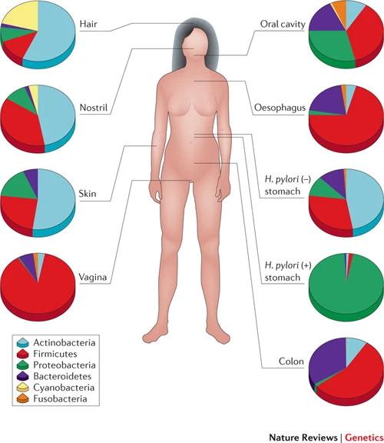
www.hologen-network.eu
Cho & Blaser et al. 2012

Slide 8
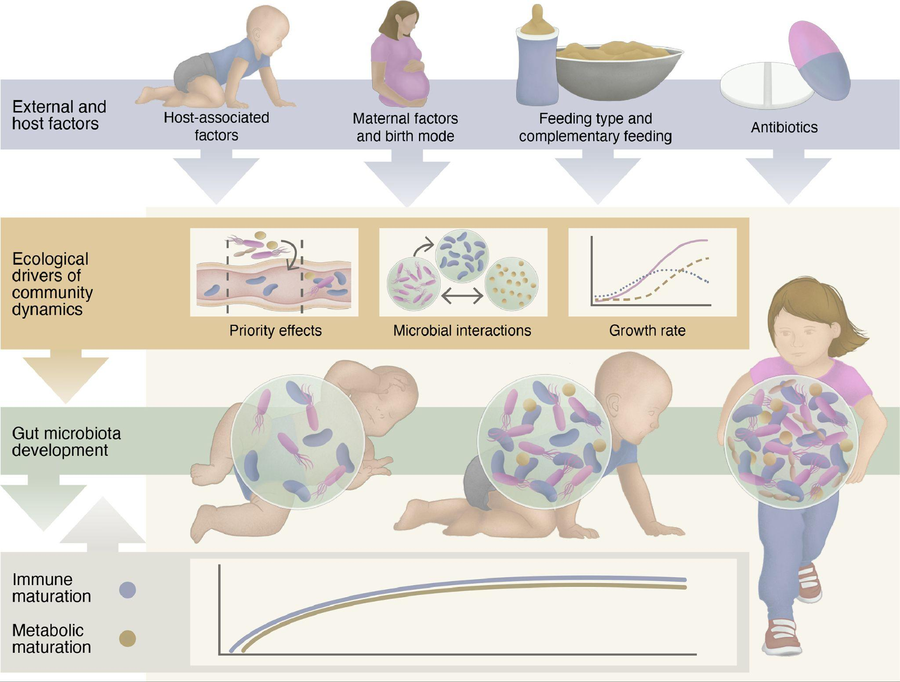
www.hologen-network.eu
Jian et al. 2021

Slide 9
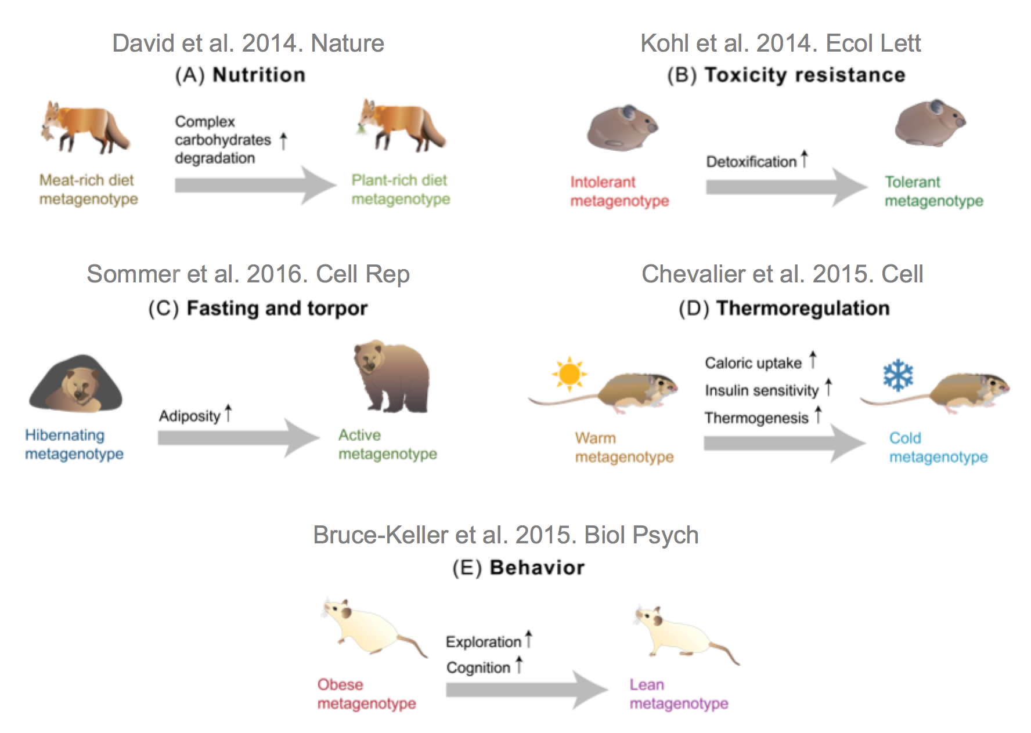
www.hologen-network.eu
Alberdi et al. 2016

Slide 10
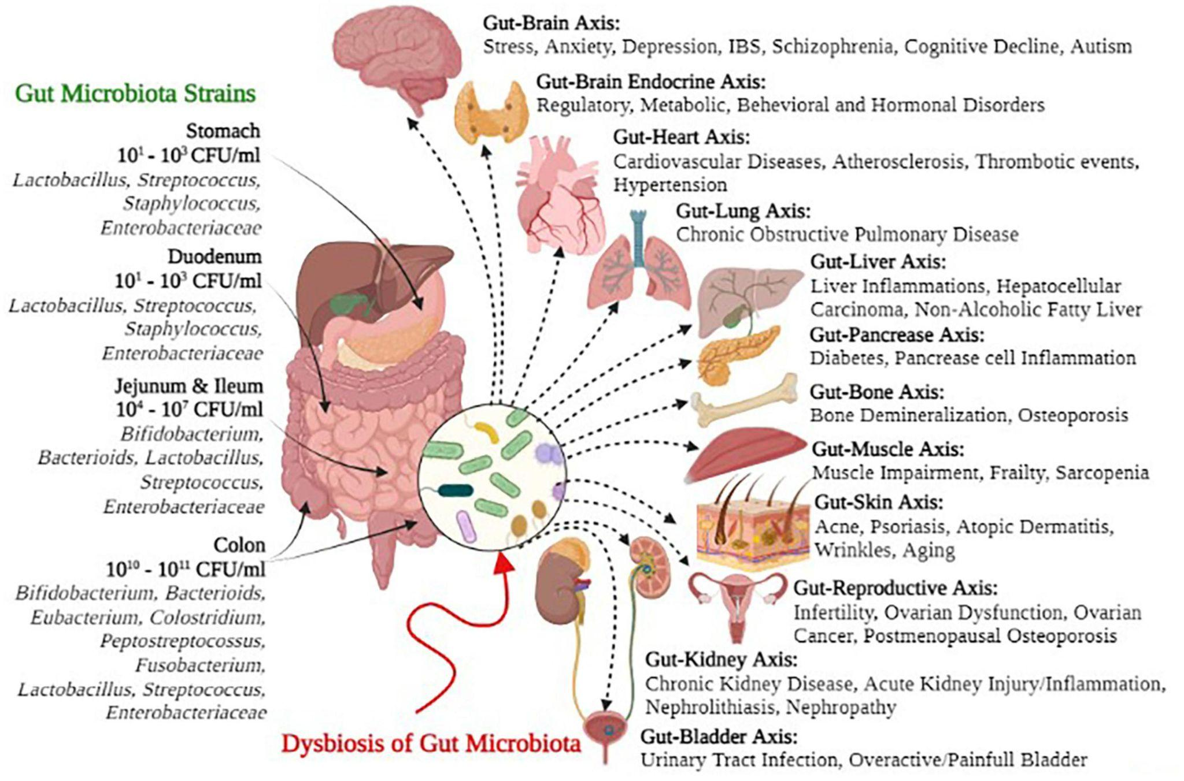
www.hologen-network.eu
Afzaal et al. 2022

Slide 11
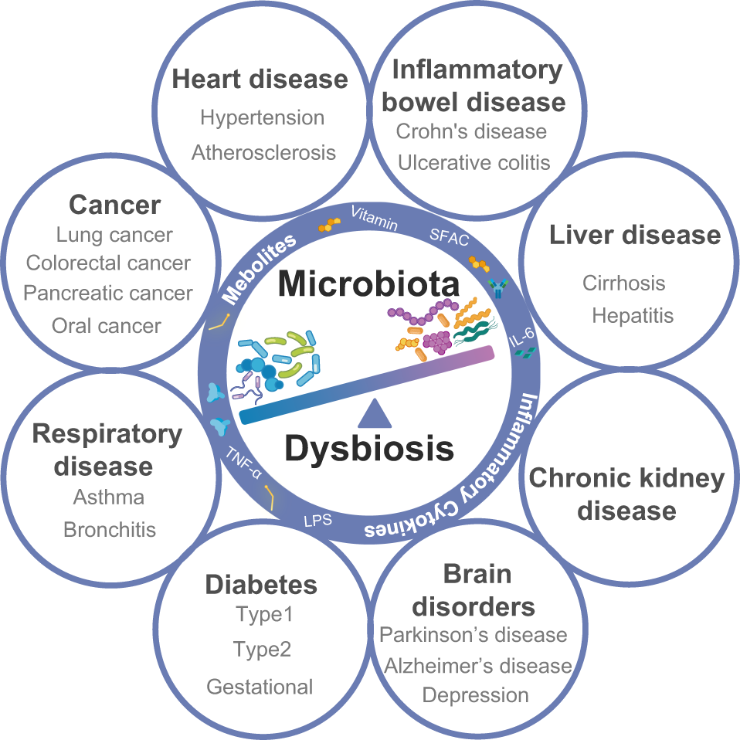
www.hologen-network.eu
Hou et al. 2022

Slide 12
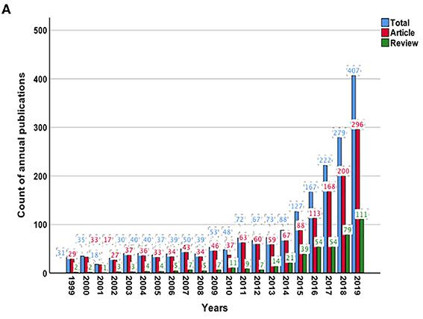
www.hologen-network.eu
Zhu et al. 2021

Slide 13
www.hologen-network.eu
Why don't we use microbes more often as a treatment?

Slide 14
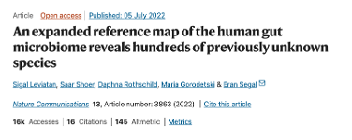
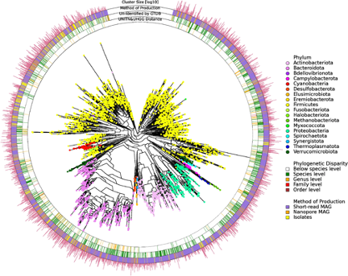
www.hologen-network.eu
Causality
Unidentified mechanisms
Complexity
Microbes
- the mechanisms through which vagal afferents become activated by the gut microbiota are currently unclear.
- Although the mechanisms responsible for such effects were not fully understood…
- However, the mechanisms linking microbiota to social neurodevelopment are not well understood.
Phenotype
Disease

Slide 15
www.hologen-network.eu

Slide 16

www.hologen-network.eu
Microbes
Metabolites
Structural components
LPS, SCFA…

Slide 17
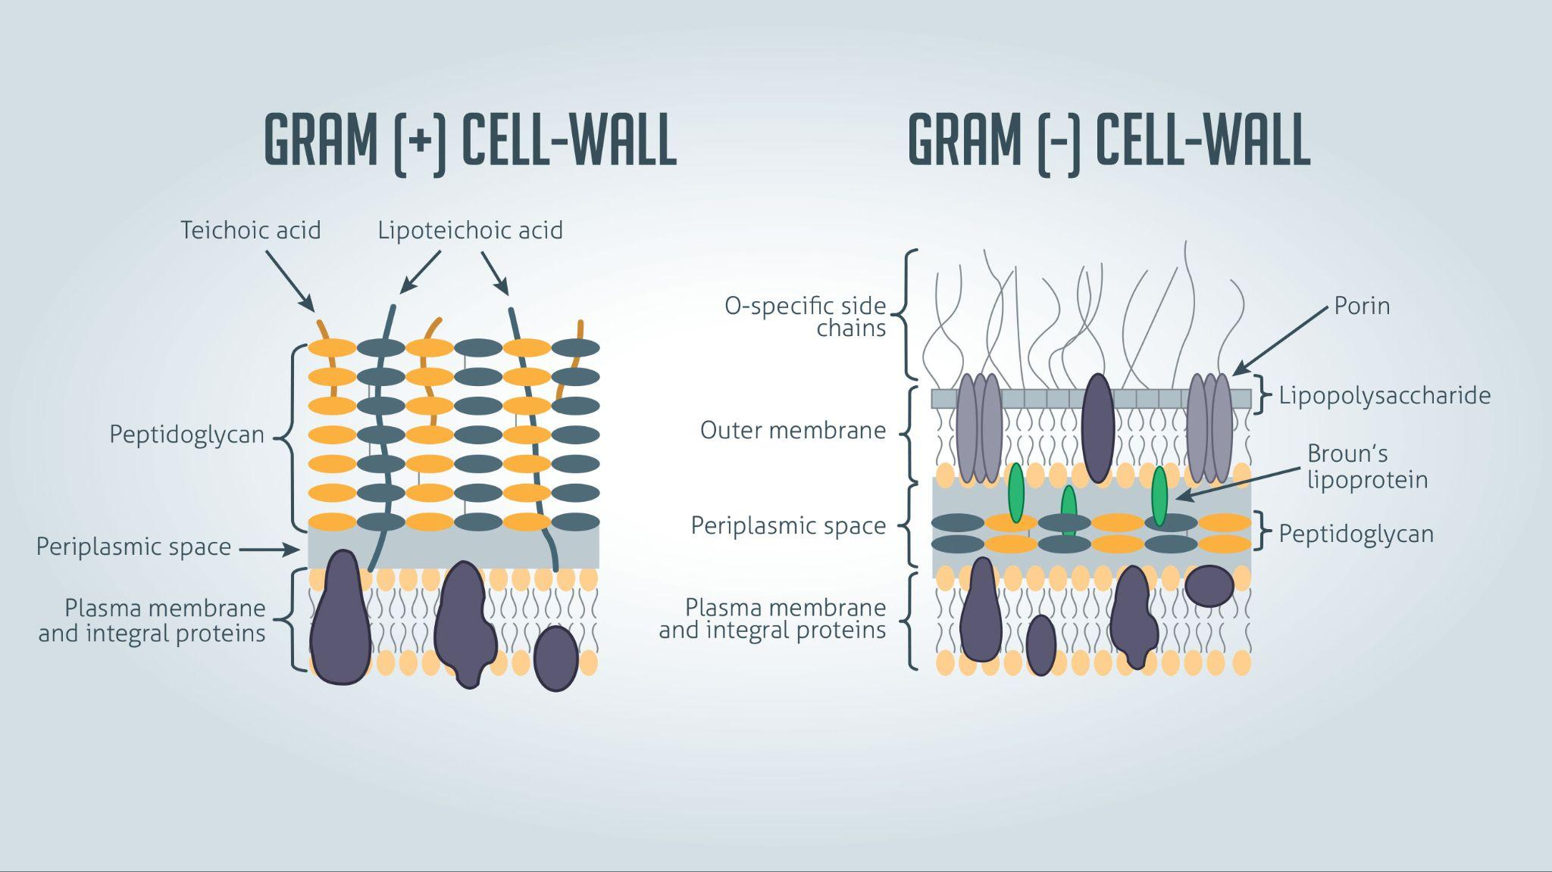
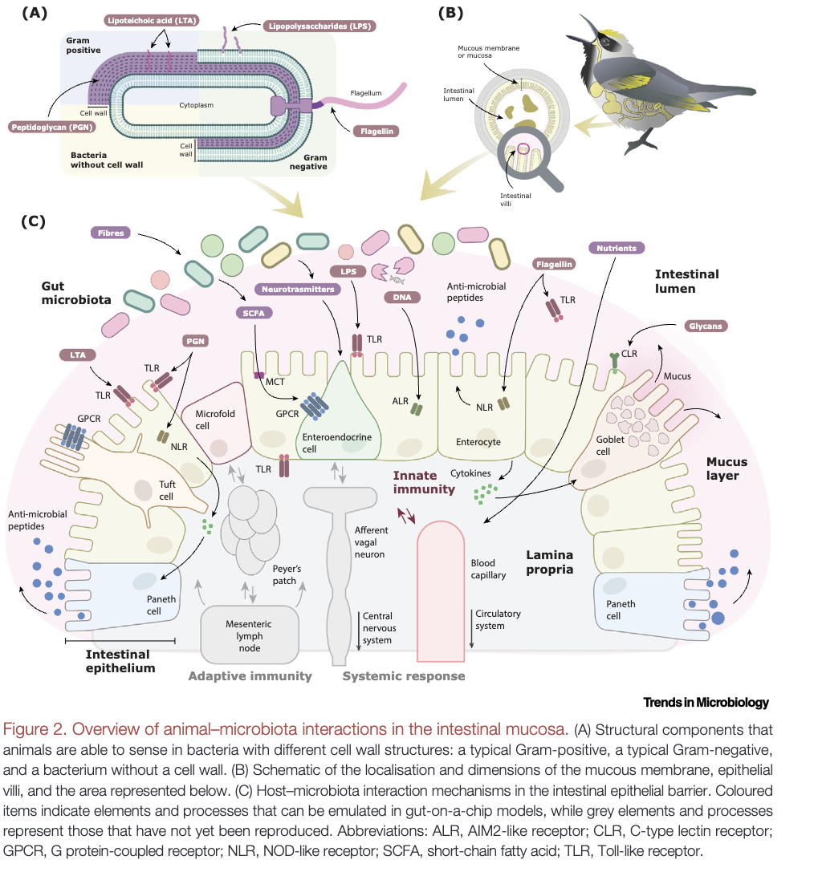
www.hologen-network.eu
Structural components & Metabolites
Aizpurua et al. 2023
Technology Networks

Slide 18
www.hologen-network.eu
Microbes
Metabolites
Structural components
LPS, SCFA…
Receptors
TLR, NLR, GPCR…

Slide 19
www.hologen-network.eu
Aizpurua et al. 2023

Slide 20
www.hologen-network.eu
Microbes
Response
AMP, IgA…
Metabolites
Structural components
LPS, SCFA…
Receptors
TLR, NLR, GPCR…

Slide 21
www.hologen-network.eu
Microbes
Response
AMP, IgA…
Metabolites
Structural components
LPS, SCFA…
Receptors
TLR, NLR, GPCR…

Slide 22
www.hologen-network.eu
Aizpurua et al. 2023

Slide 23
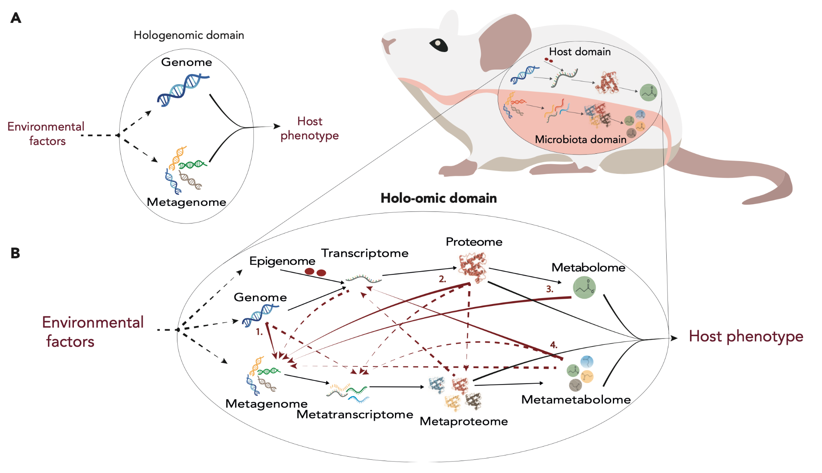
www.hologen-network.eu
Nyholm et al. 2020

Slide 24
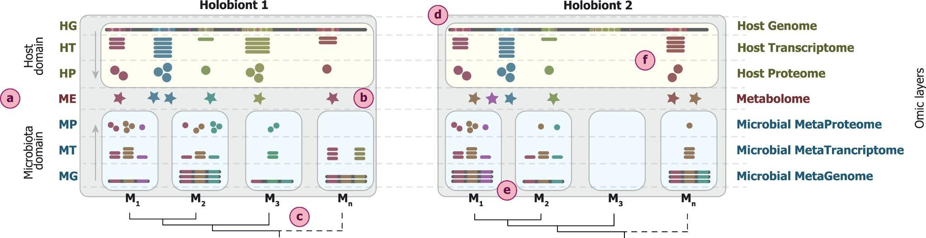
www.hologen-network.eu
Host-microbiota multi-omic landscape
Odriozola et al. 2024

Slide 25
www.hologen-network.eu
Study design
Research question
Hypothesis

Slide 26
www.hologen-network.eu
Is it your research observational or experimental?

Slide 27
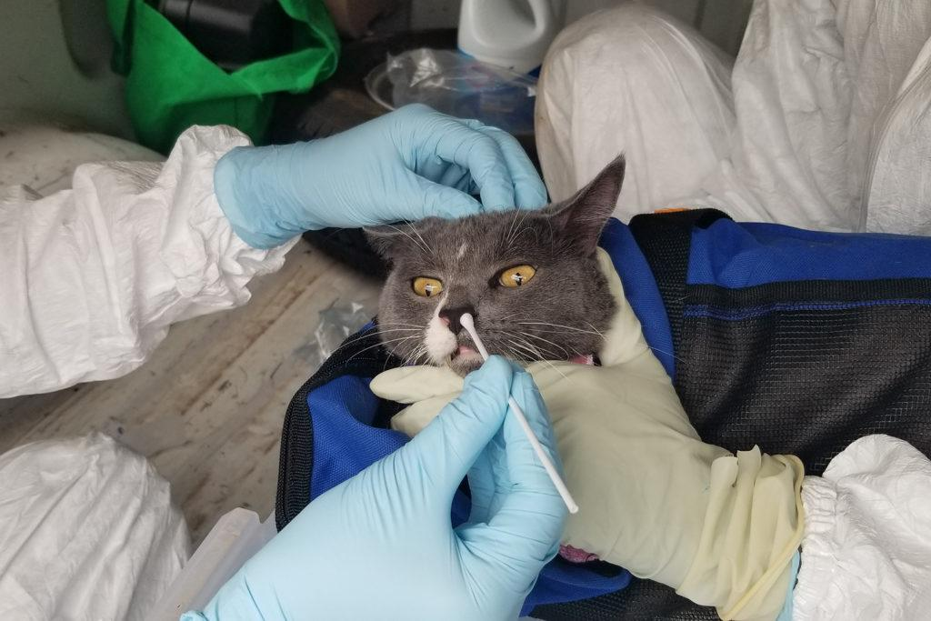
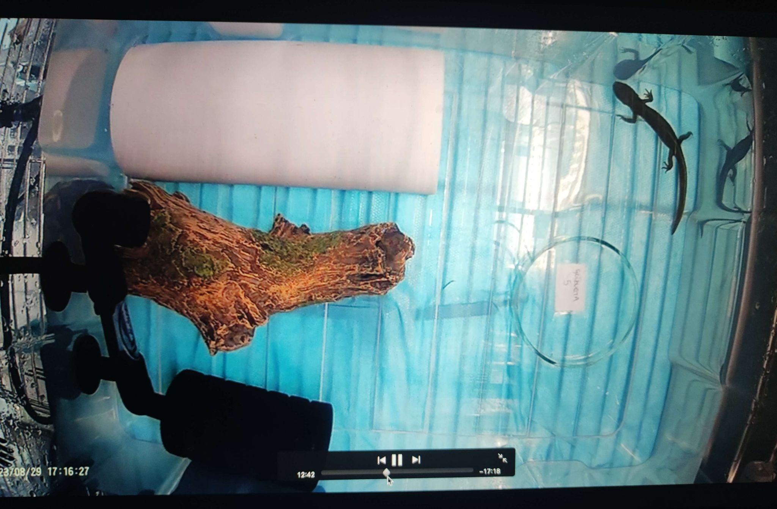
TEREX12 from Pixabay
www.hologen-network.eu
Research study
Observational
Experimental
Texas A&M College of Veterinary Medicine & Biomedical Sciences
Garazi Martin-Bideguren

Slide 28
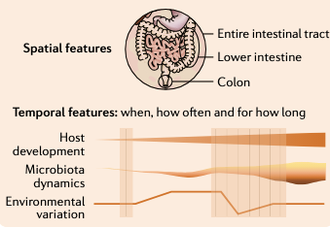
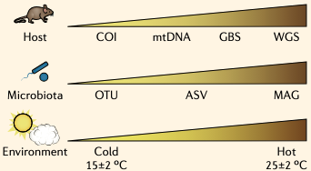
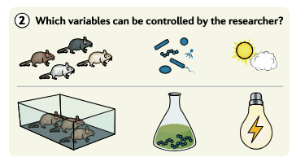
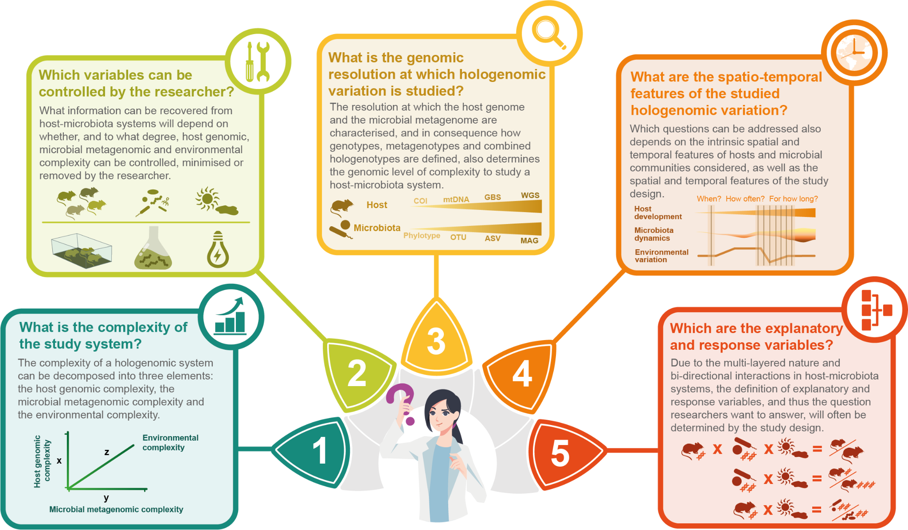
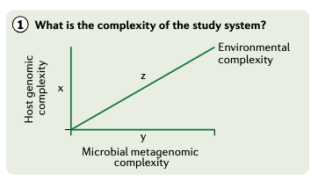
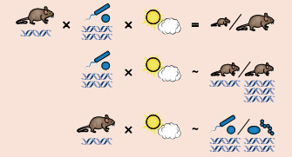
www.hologen-network.eu
4) What are the spatiotemporal features of the studies hologenomic variations?
3) What is the resolution at which hologenomic variation is studies?
2) Which variables can be controlled?
1) What is the complexity of the study system?
5) Which are the explanatory and response variables?
Alberdi et al. 2021 Nature Reviews Genetics

Slide 29
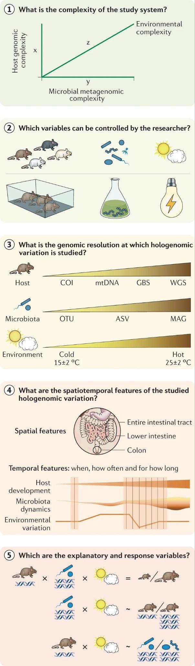
www.hologen-network.eu

Slide 30
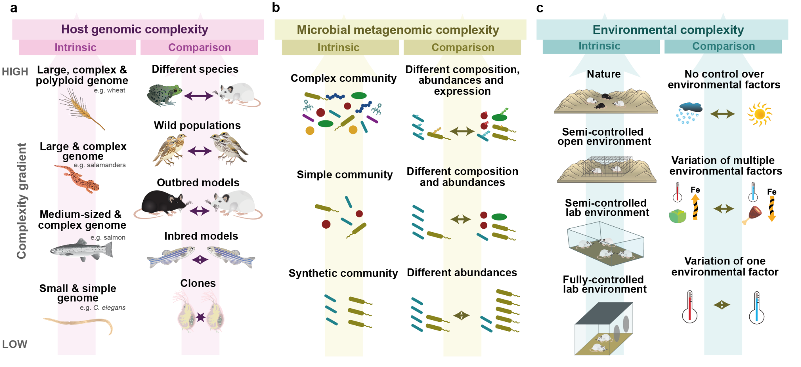
www.hologen-network.eu
Alberdi et al. 2021

Slide 31
www.hologen-network.eu

Slide 32
www.hologen-network.eu

Slide 33
www.hologen-network.eu

Slide 34
www.hologen-network.eu
Nyholm et al. 2020

Slide 35
www.hologen-network.eu

Slide 36
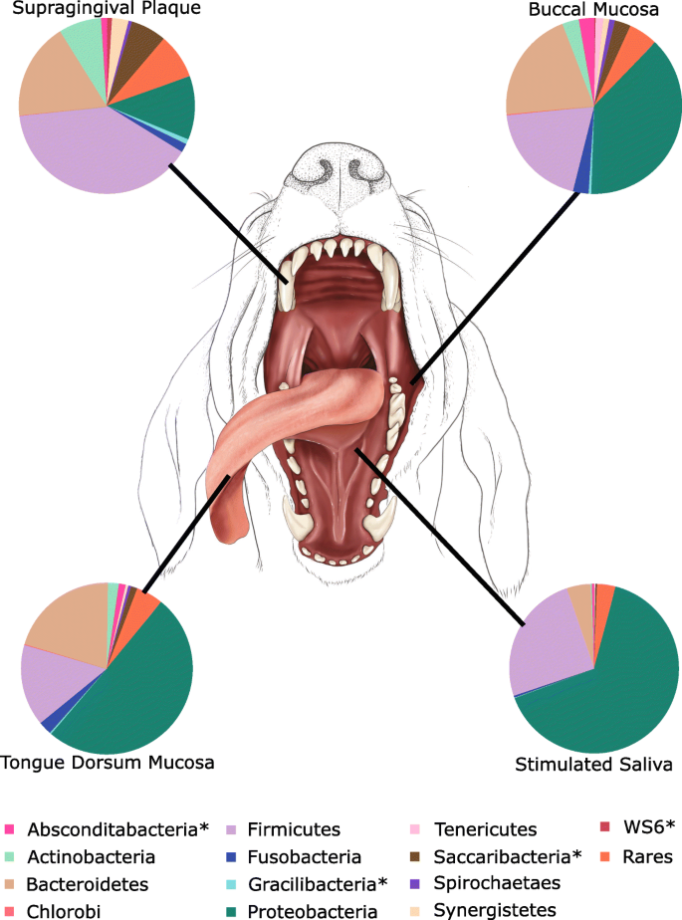
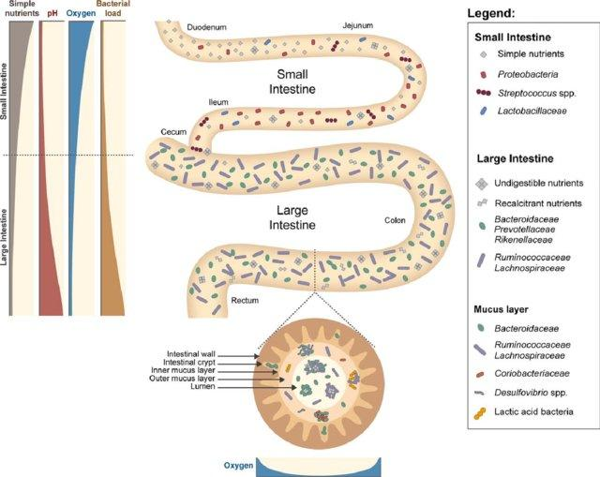
www.hologen-network.eu
Spatial features
Pereira & Berry 2017
Ruparell et al. 2020

Slide 37
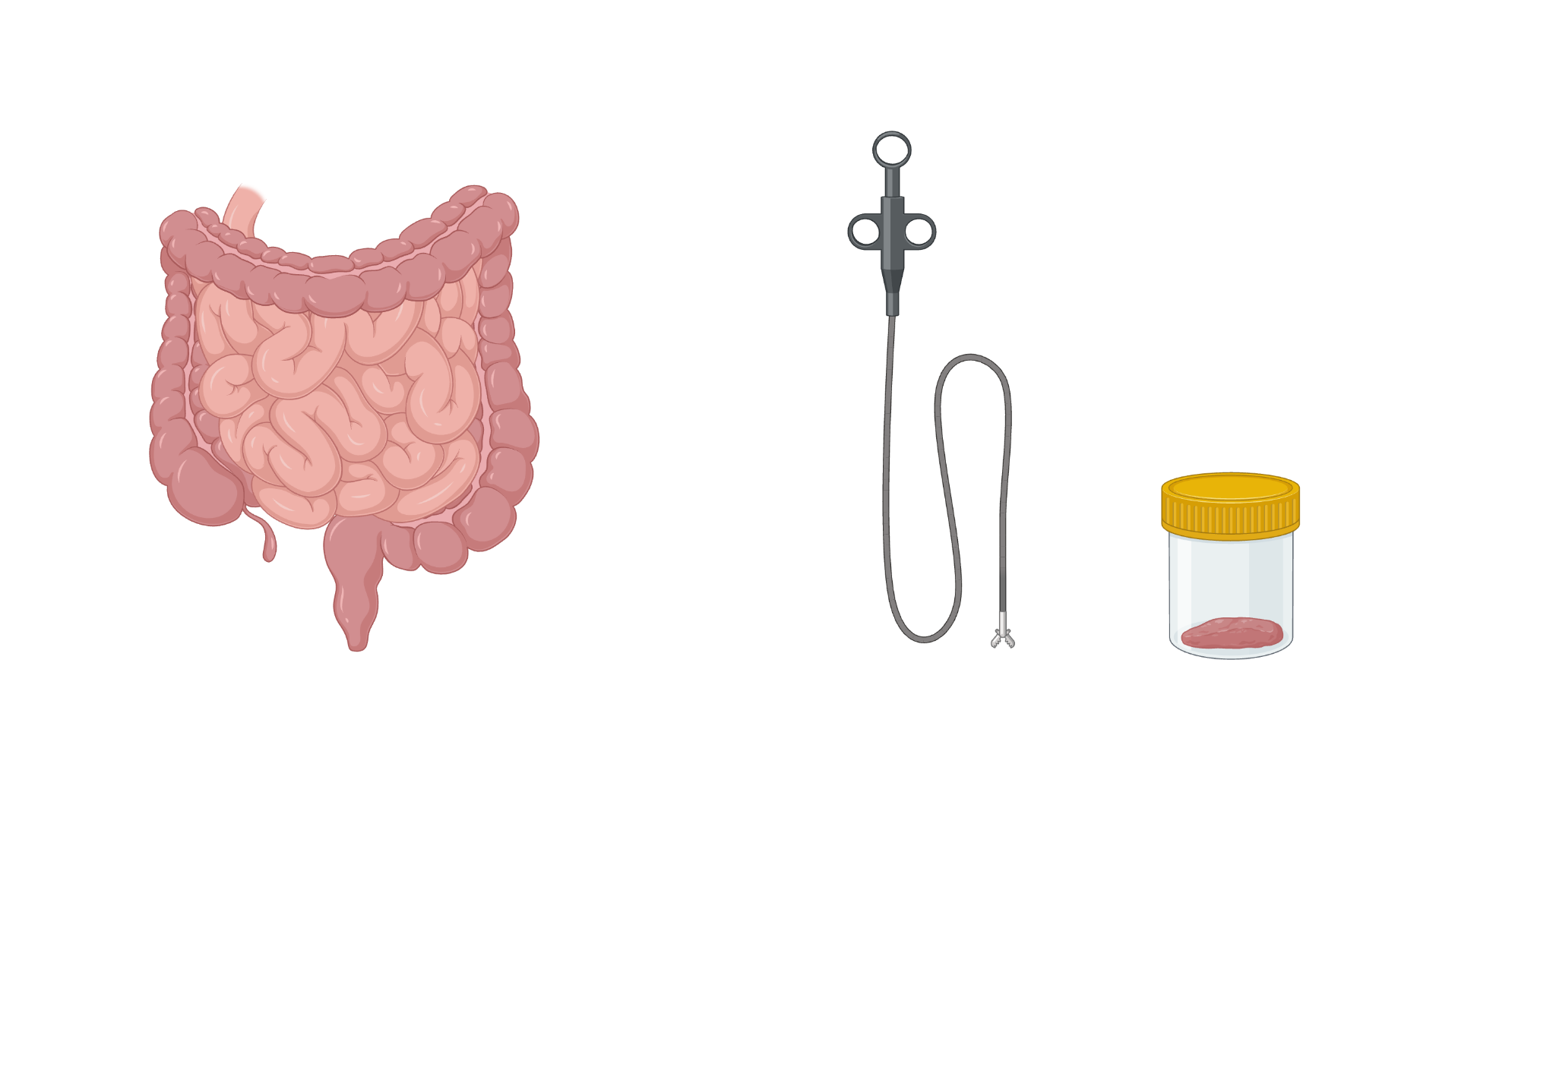
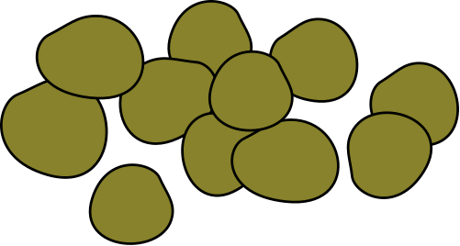

www.hologen-network.eu
Representativeness
Intestine
Faecal samples

Slide 38
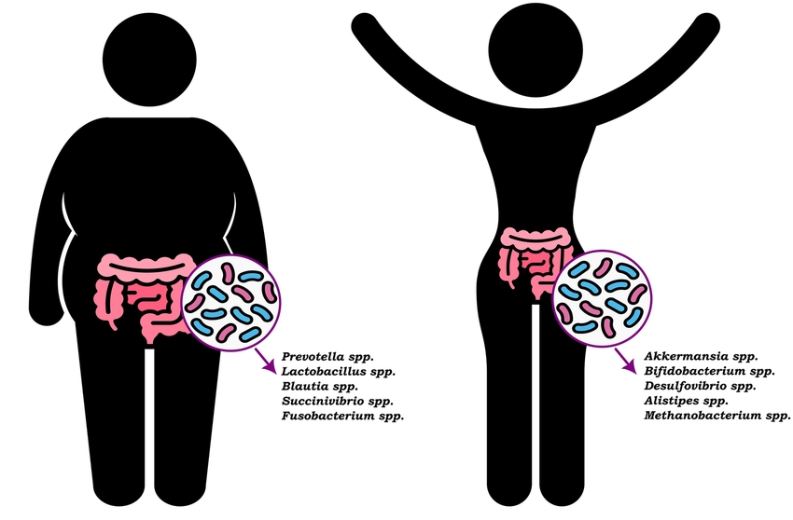
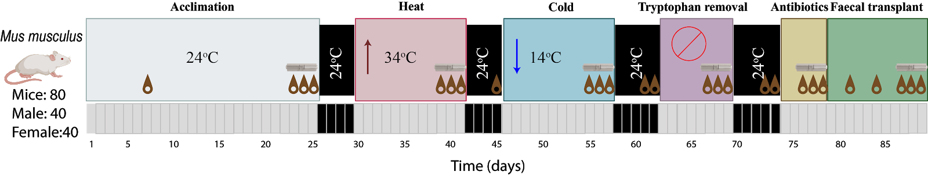
www.hologen-network.eu
Temporal features
Snapshot
Longitudinal
Lange et al. 2023

Slide 39
www.hologen-network.eu
Long and complicate journey
Sample collection and preservation
Laboratory processing
Bioinformatic processing
Analysis and statistics
Many decisions to be made

Slide 40
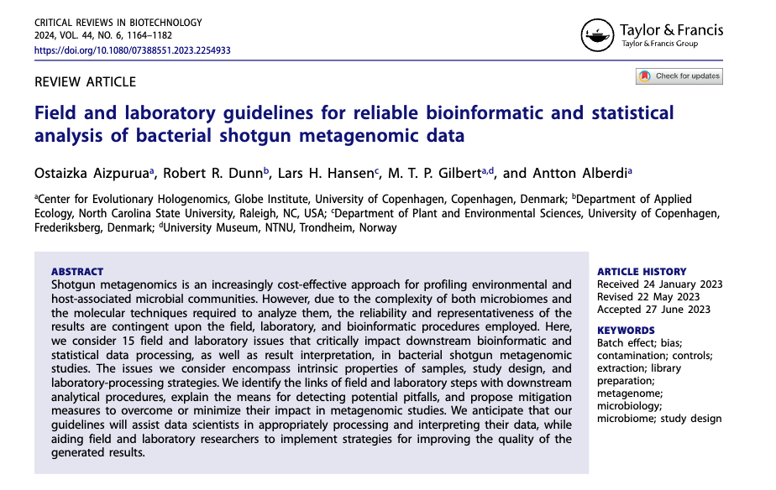
www.hologen-network.eu

Slide 41

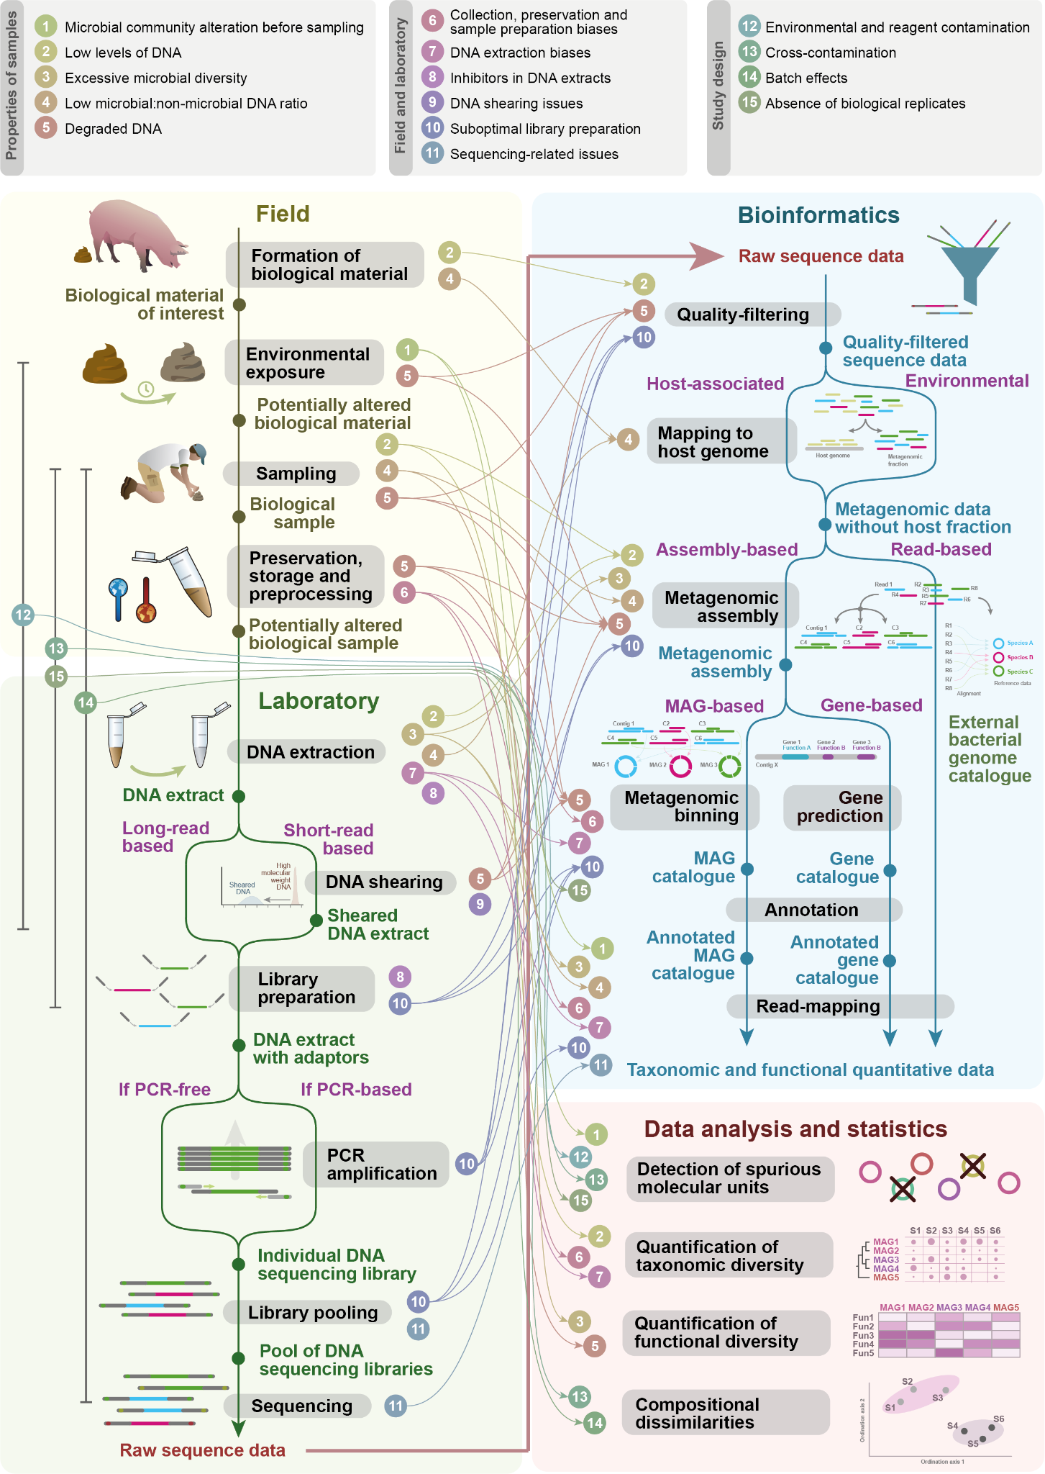


Slide 42
www.hologen-network.eu
Microbial:non-microbial DNA
Microbes DNA
Dietary DNA
Host DNA
Others

Slide 43
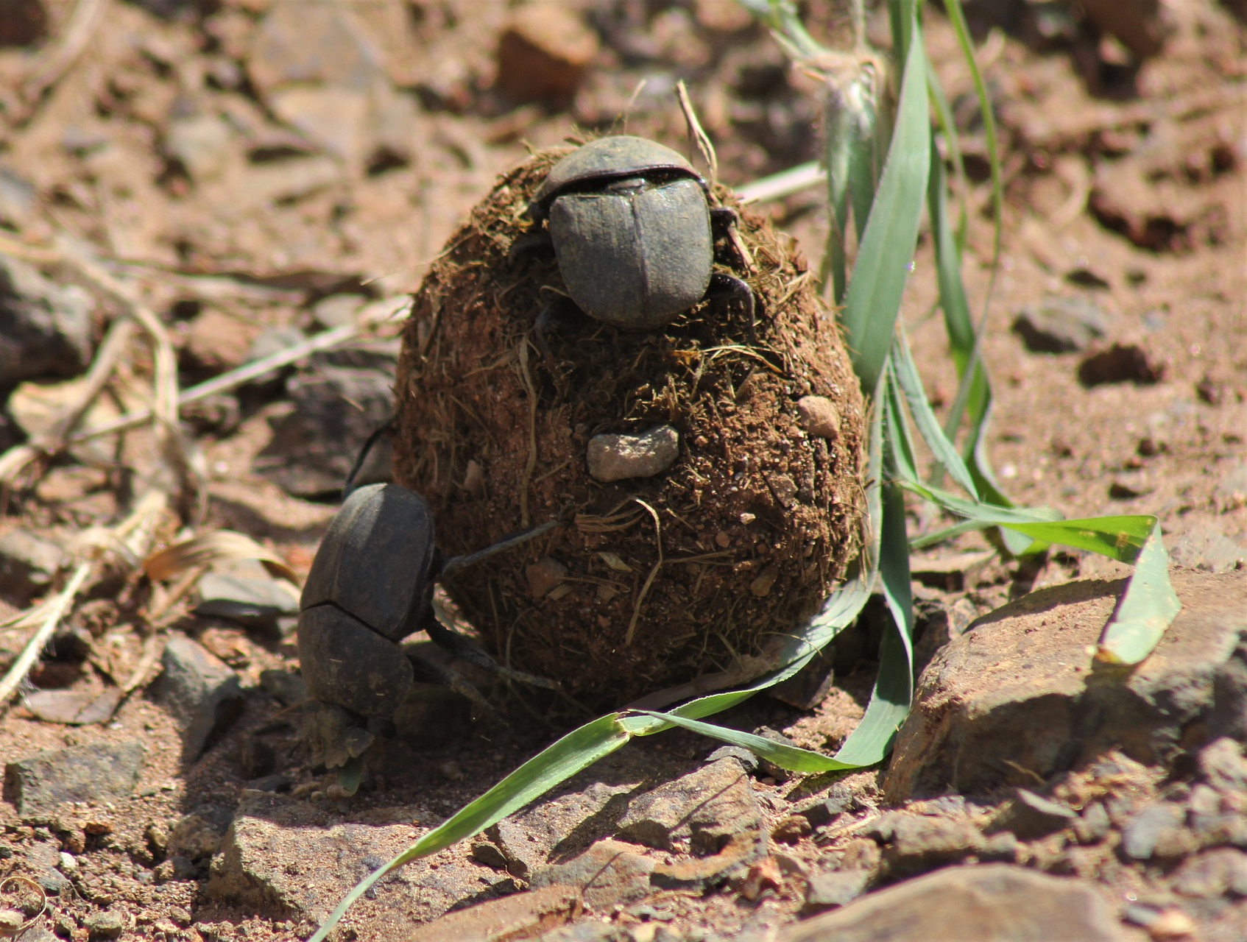

www.hologen-network.eu
Representativeness: collection
Faecal samples
Environmental contamination
Changes in bacteria
Damage DNA
Image by Nel Botha from Pixabay

Slide 44
www.hologen-network.eu
Preservation & Storage
Collections time
Temperature
Buffer
Storage time

Slide 45
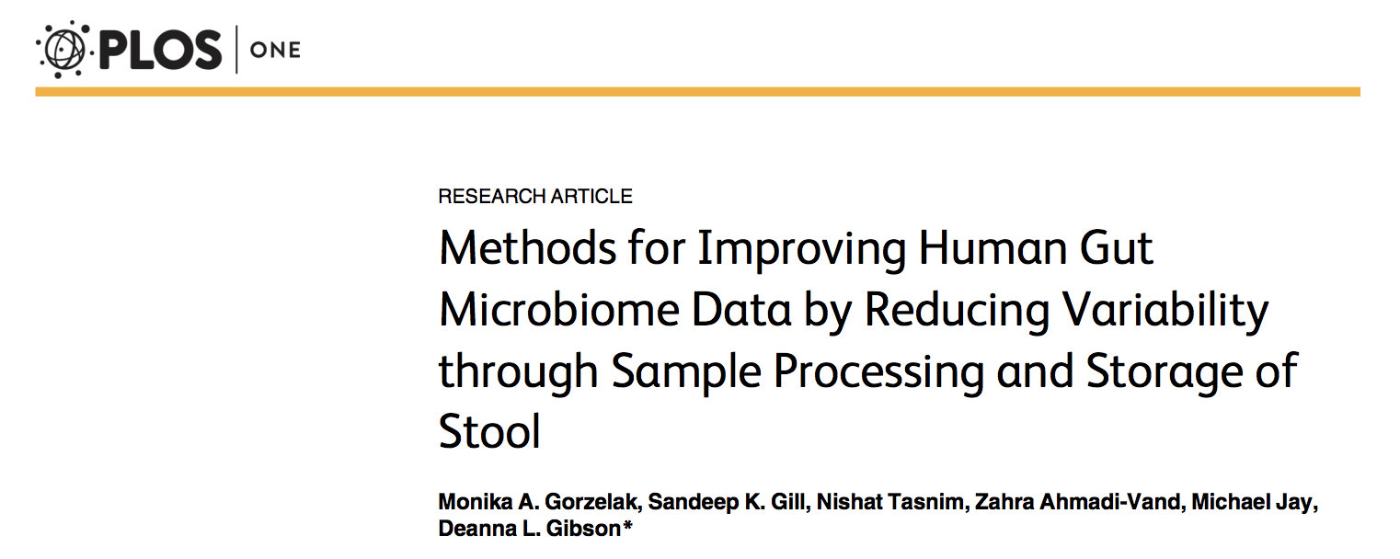

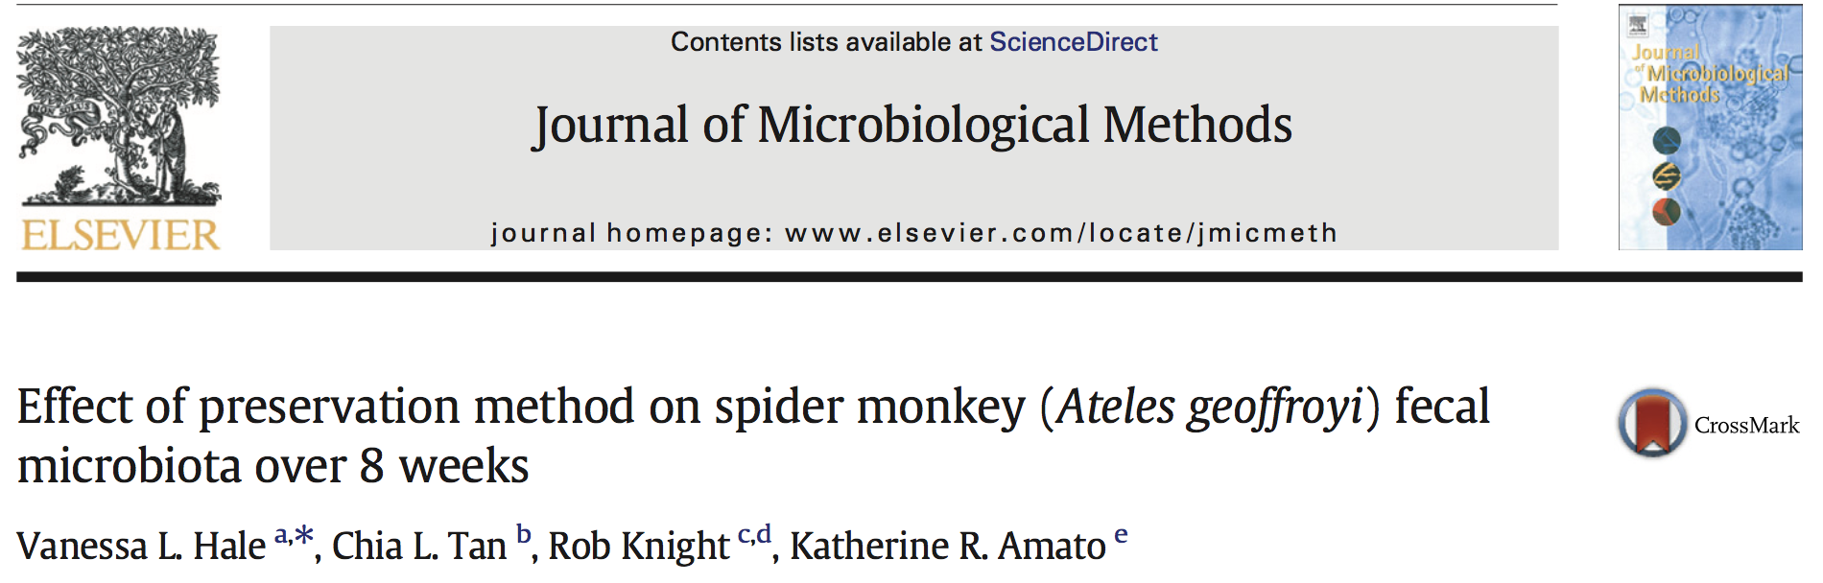
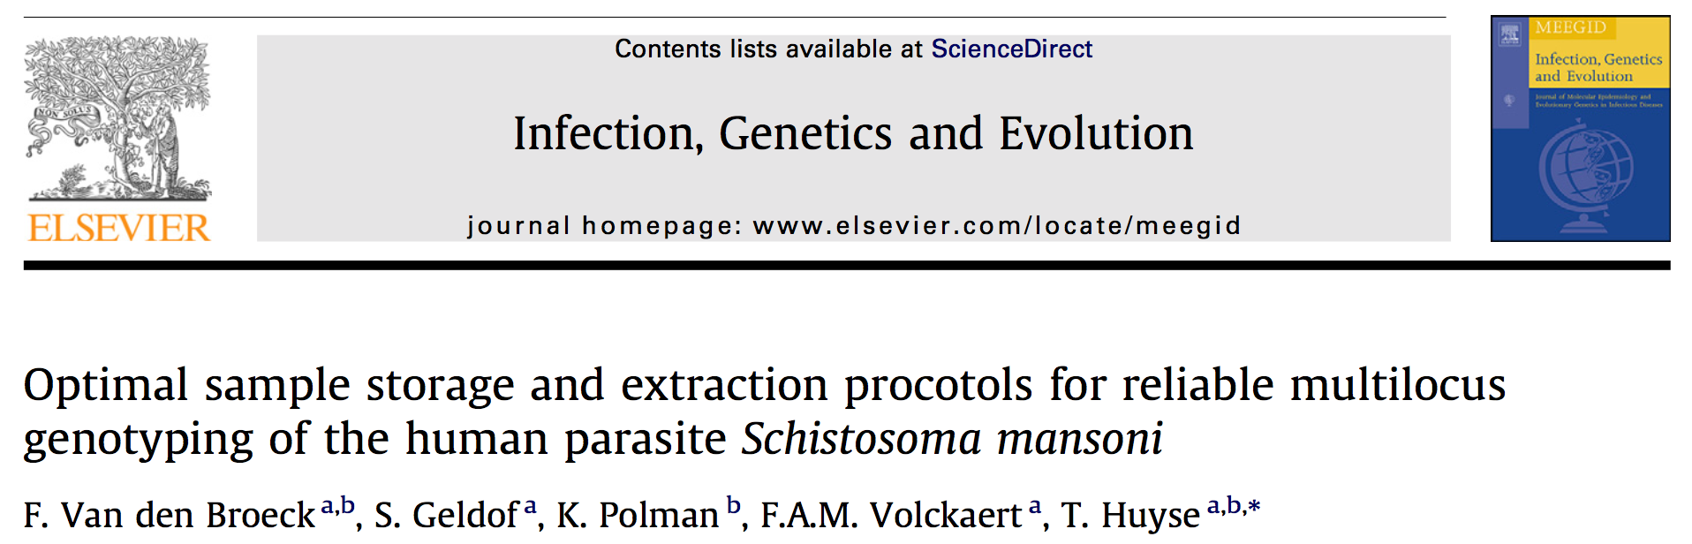
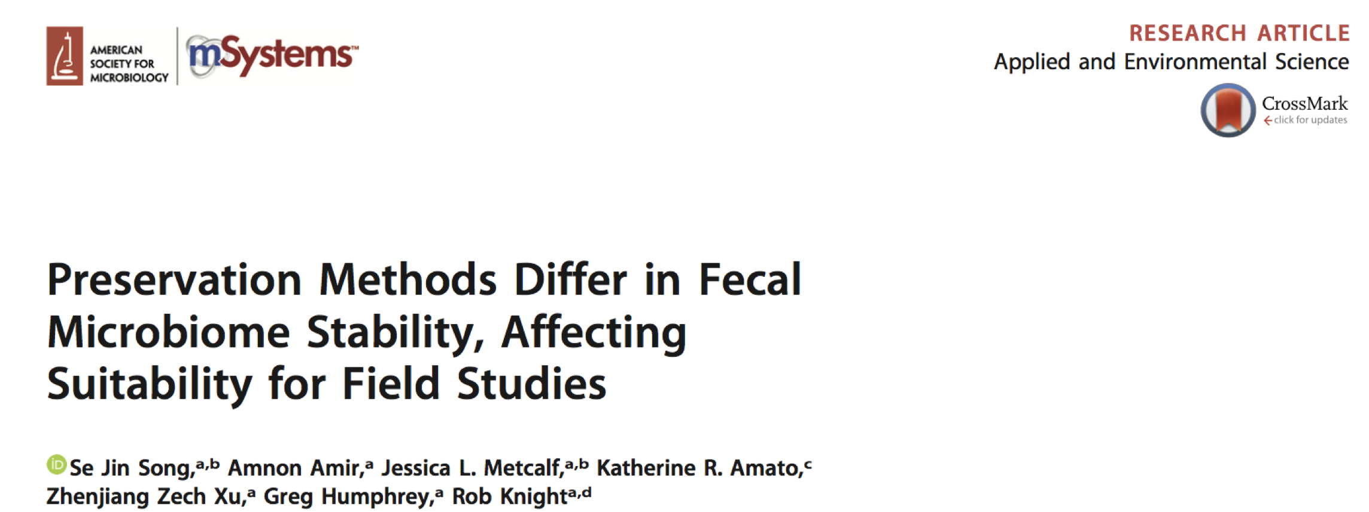

www.hologen-network.eu
Preservation & Storage

Slide 46

www.hologen-network.eu
Image by Kiều Trường from Pixabay
Be consistent

Slide 47
PhD project:
Hologenomic domains
Complexity of each of the element: host, microbes, environment
Genomic resolution
Sample type representativeness & spatiotemporal features
Sample collection, preservation & storage

